Slide 1
Lecture 6: Chemical reactions
California State University, Fullerton
2023 Fall Semester – Chem 123

Slide 2
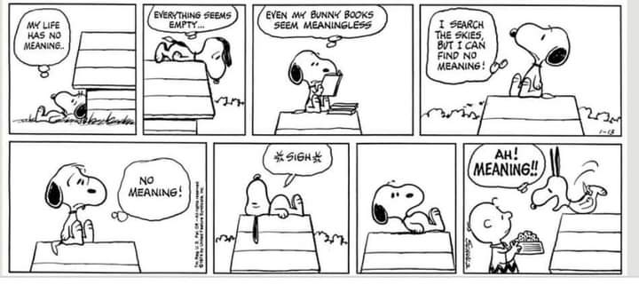
QUESTIONS, COMMENTS, AND CONCERNS?

Slide 3
Outline
Announcements
Ch. 4: Chemical reactions
Chemical equations – balancing the equation
Types of Chemical Reactions
Compounds in aqueous solution
Precipitation reactions – solubility rules
Ionic and net ionic equations
Acid-Base reactions
Oxidation States and Redox reactions

Slide 4
Announcements
Ch. 3 Homework due Thurs, Sept 14
In-progress grading the in-class: nomenclature
Common Errors – stay with the formal way of naming
Communicate!
Practice! Practice! Practice!
First exam week 5 on Weds, Sept 20th – covering Ch 1-4; 5-6 free response questions
Post study guide end of Thurs, Sept 14

Slide 5
Outline
Announcements
Ch. 4: Chemical reactions
Chemical equations – balancing the equation
Types of Chemical Reactions
Compounds in aqueous solution
Precipitation reactions – solubility rules
Ionic and net ionic equations
Acid-Base reactions
Oxidation States and Redox reactions

Slide 6
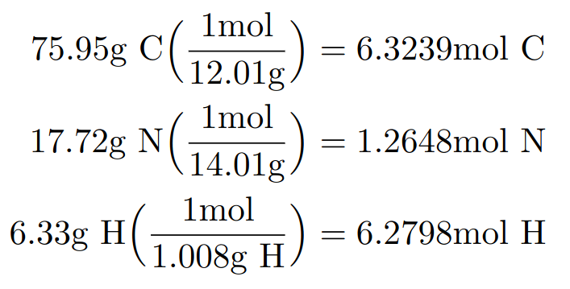
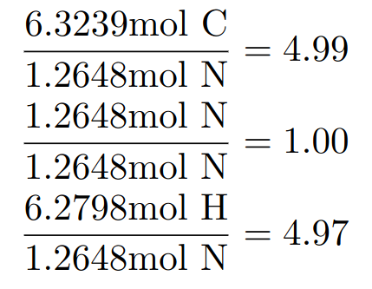
Example: determine empirical and molecular formula
A major textile dye manufacturer developed a new yellow dye. The dye has a percent composition of 75.95% C, 17.72% N, and 6.33% H by mass with a molar mass of about 240 g/mol. Determine the molecular formula of the dye.
Empirical formula: C₅H₅N

Slide 7
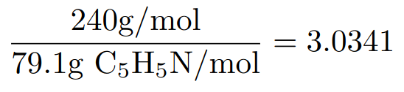
Example: determine empirical and molecular formula
A major textile dye manufacturer developed a new yellow dye. The dye has a percent composition of 75.95% C, 17.72% N, and 6.33% H by mass with a molar mass of about 240 g/mol. Determine the molecular formula of the dye.
Empirical formula: C₅H₅N
Molecular formula: C₁₅H₁₅N₃

Slide 8
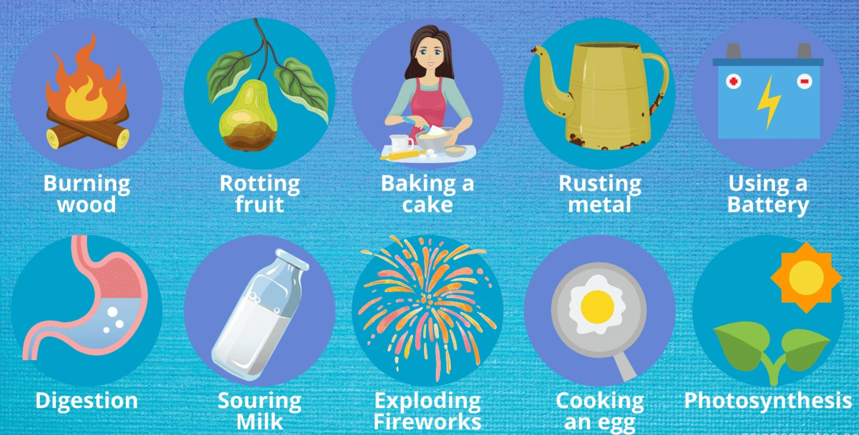
Recall: signs of Chemical reaction
Change in color, change in temperature (heat), formation of a gas, formation of solid, and odor change

Slide 9
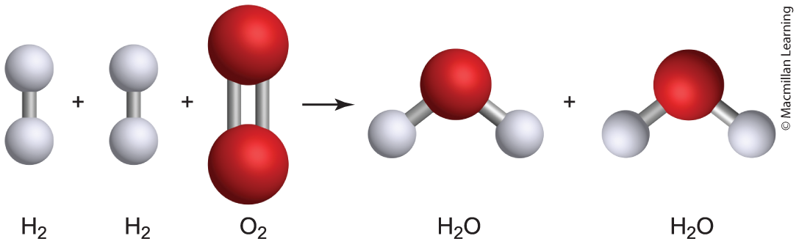
Chemical equation
aA + bB ---> cC + dD
General form of chemical equation is reactants (A, B) on the left and products (C, D) on the right
Coefficients a, b, c, and d in front of the chemical compound
Example: 2 H₂(g) + O₂(g) ---> 2 H₂O(g)

Slide 10
Chemical equation: Importance of coefficents
aA + bB ---> cC + dD
Balances the chemical equation due to the Law of Conservation of Mass
Number of atoms on the reactant side equals to number of atoms on the product side
Example: 2 H₂(g) + O₂(g) ---> 2 H₂O(g)

Slide 11
Chemical equation: Units of the coefficients
aA + bB ---> cC + dD
Mentioned in the previous side, the coefficient represents number molecules
Q: Coefficient represents something else. Hint: Recall Avogadro's number
Example: 2 H₂(g) + O₂(g) ---> 2 H₂O(g)

Slide 12
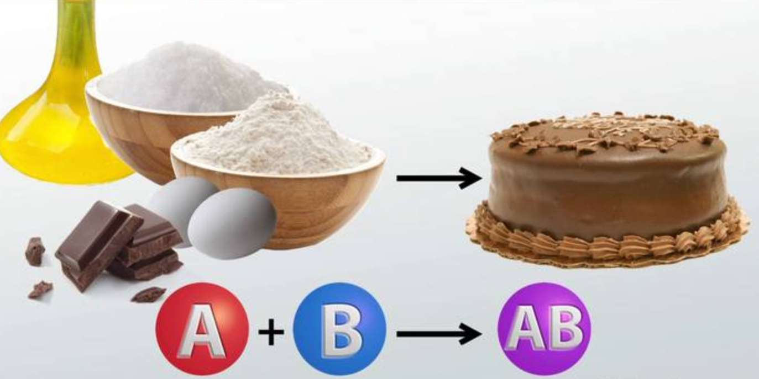
Chemical equation: Analogy to cookbook
Baking a cake
Reactant:
3 Eggs
2 Cups flour
2 Cups sugar
1 Chocolate bar
¾ Cup vegetable oil
Product:
1 Chocolate cake

Slide 13

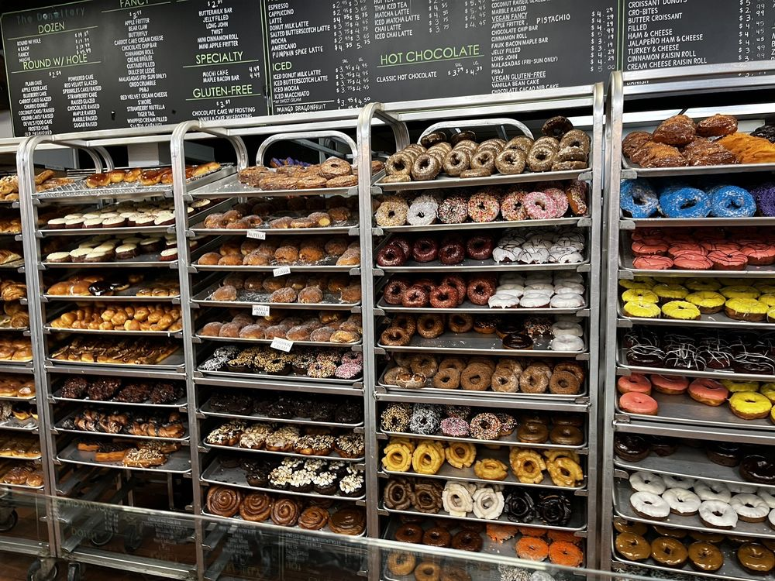

Chemical equation: fancy donuts

Slide 14
Chemical equation: Analogy to cookbook
Example: 2 H₂(g) + O₂(g) ---> 2 H₂O(g)
Every 2 moles H₂(g) and 1 mole O₂(g), there are 2 moles H₂O(g) produced

Slide 15
Chemical equations: physical states
Note: Phases must be written out for each compound
Gas – denoted as (g)
Liquid – denoted as (l)
Solid – denoted as (s)
Aqueous – denoted as (aq); compound dissolved in water

Slide 16
Tips: Balancing chemical equations
Note: Trial and Error approach
Polyatomic ions can be balanced as a unit and not as separate elements e.g. SO₄²⁻ can be considered a whole unit
Change coefficient to balance elements one-by-one that appear in the reactant and product
Verify the number of each type of atom on reactant and product sides
Example: SO₂(g) + O₂(g) ---> SO₃(g)
Reactant – 1 S, 4 O; Product 1 S, 3 O – unbalanced
2 SO₂(g) + O₂(g) ---> 2 SO₃(g)
Reactant – 2 S, 6 O; Product 2 S, 5 O – balanced

Slide 17
Tip: Balancing combustion reaction
Generic Combustion Reaction (hydrocarbons):
aC_{x}H_{y}(g) + bO₂(g) --> cCO₂(g) + dH₂O(g)
x,y – subscripts for generic hydrocarbon (made up of only H and C)
a,b,c,d are coefficients
Balance the carbon and hydrogen first
Balance the oxygen
Multiply by a number to get integer values coefficients

Slide 18
Example: balance combustion of C₈h₁₈
aC₈H₁₈(g) + bO₂(g) --> cCO₂(g) + dH₂O(g)
Determine the coefficients C₈H₁₈(g) + O₂(g) --> 8 CO₂(g) + H₂O(g) - 8 C on both sides
C₈H₁₈(g) + O₂(g) --> 8 CO₂(g) + 9 H₂O(g) - 9 H on both sides
C₈H₁₈(g) + 25/2 O₂(g) --> 8 CO₂(g) + 9 H₂O(g) - 25/2 O, then multiply by x2
2 C₈H₁₈(g) + 25 O₂(g) --> 16 CO₂(g) + 18 H₂O(g)

Slide 19
Your Turn: balance combustion of C₂h₆
aC₂H₆(g) + bO₂(g) --> cCO₂(g) + dH₂O(g)
Determine the coefficients

Slide 20
Outline
Announcements
Ch. 4: Chemical reactions
Chemical equations – balancing the equation
Types of Chemical Reactions
Compounds in aqueous solution
Precipitation reactions – solubility rules
Ionic and net ionic equations
Acid-Base reactions
Oxidation States and Redox reactions

Slide 21
Types of chemical reactions
Combination (synthesis) reaction – combining reactants to form a single complex product e.g. 4 Fe(s) + 3 O₂(g) --> 2 Fe₂O₃(s)
Decomposition reaction – reactant breaks down into smaller complexes e.g. hydrolysis of water to hydrogen and oxygen gas
Single-replacement reaction – element replaces another element within a compound e.g. Zn(s) + 2 HCl(aq) --> ZnCl₂ (aq) + H₂(g)
Double-replacement reaction – two ionic compounds exchange ions to form new compounds
Combustion reaction – Burning of a substance in the presence of oxygen gas

Slide 22
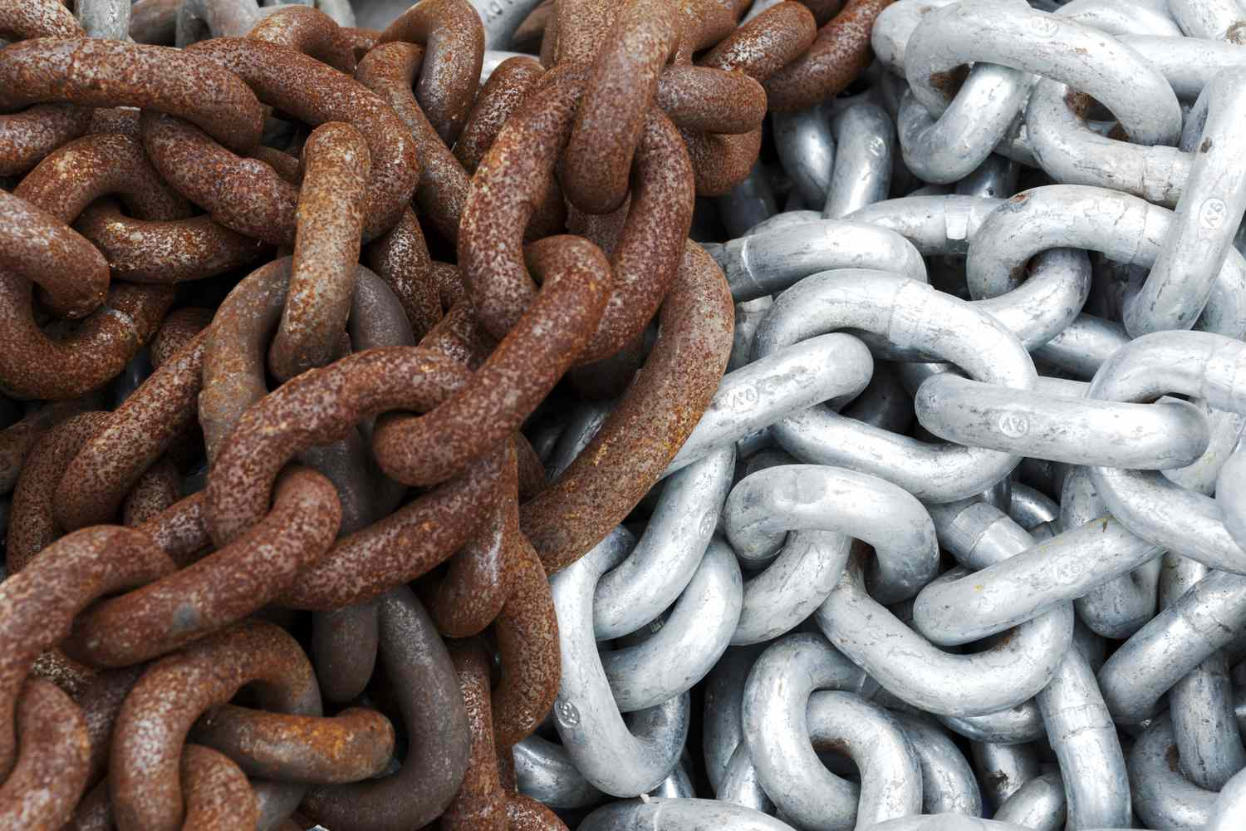
Combination (synthesis) reaction
combining reactants to form a single complex product

Slide 23
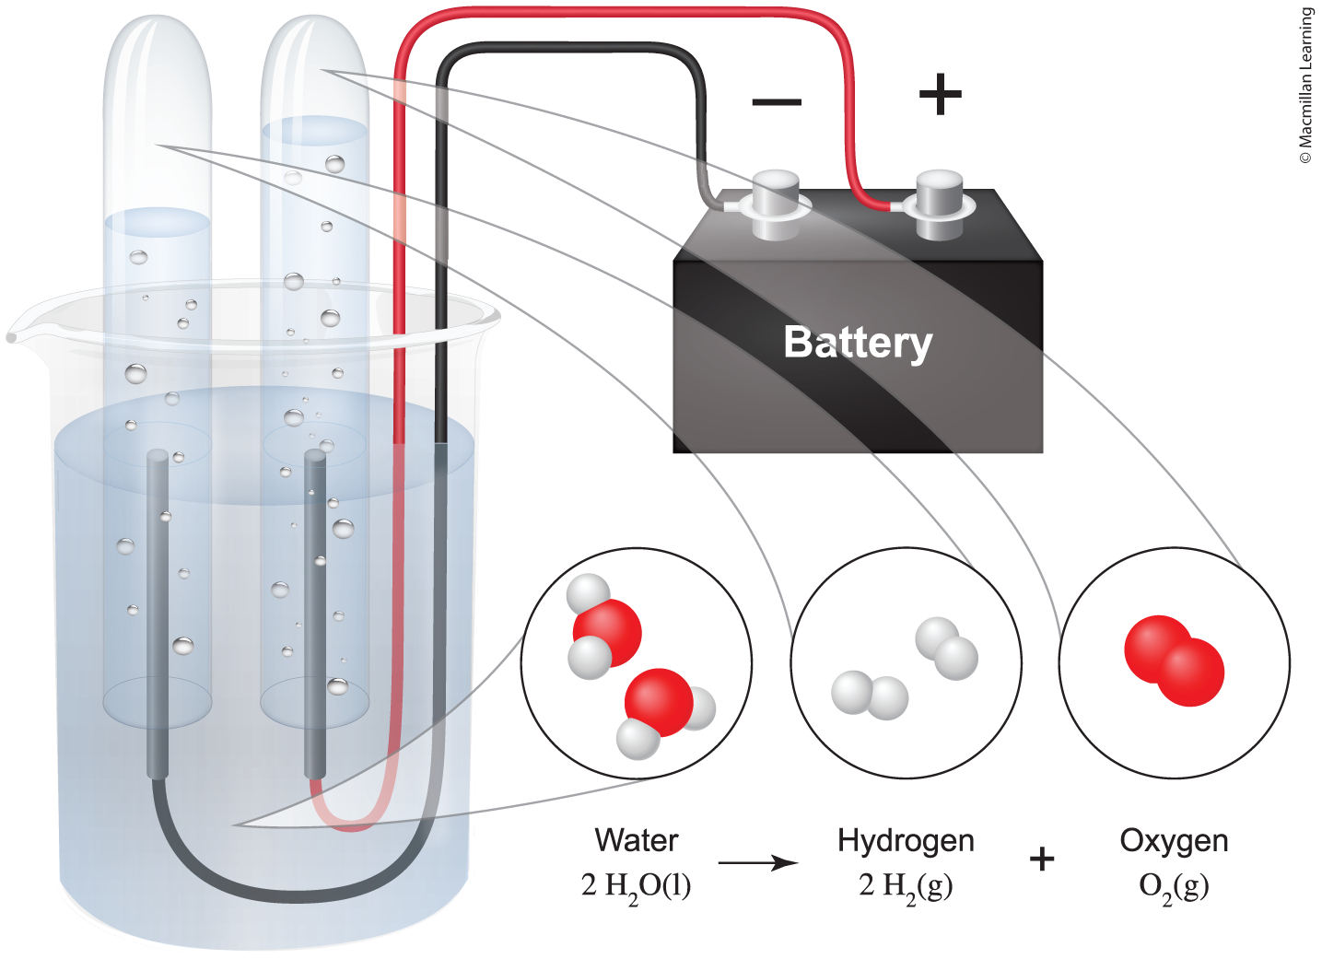
decomposition
Reactant breaks down into smaller complexes

Slide 24
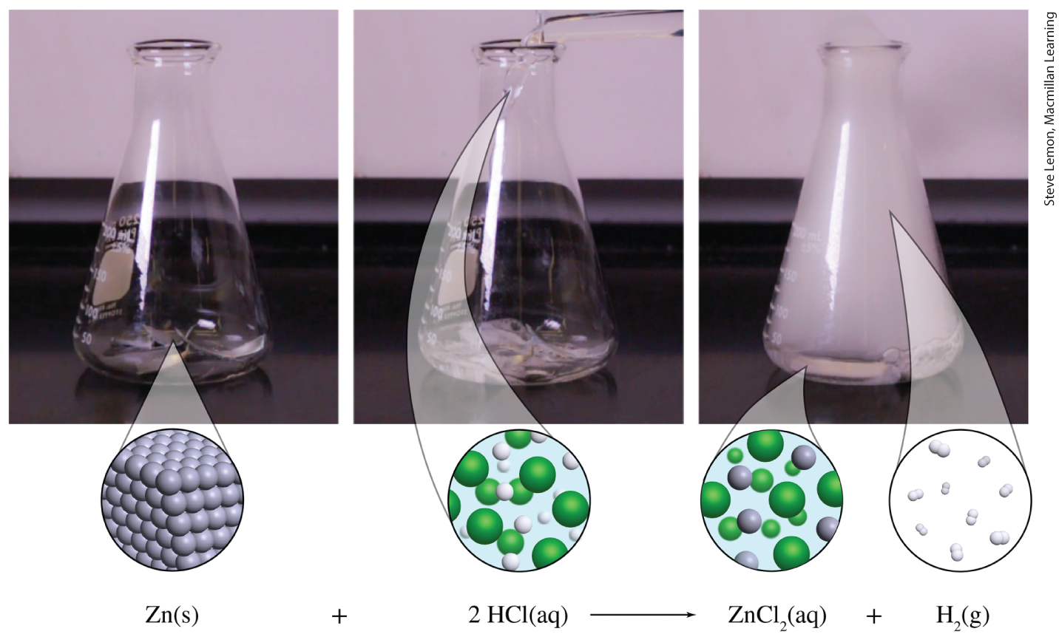
Single replacement reaction
Element replaces another element within a compound

Slide 25
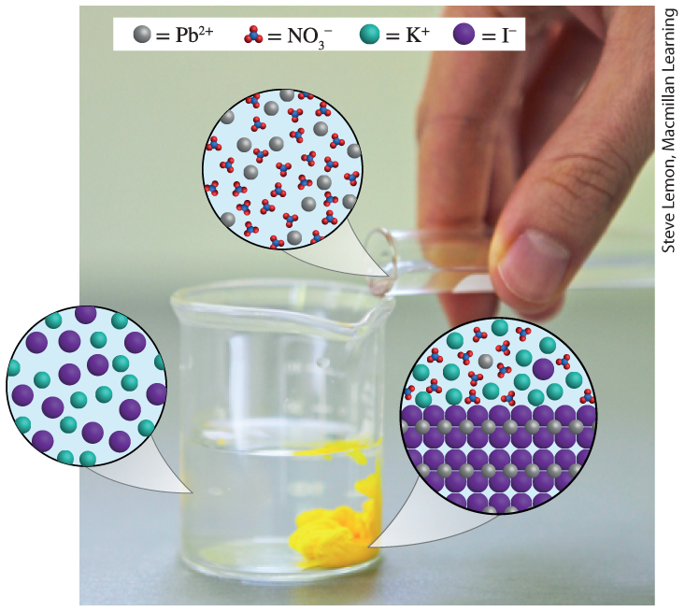
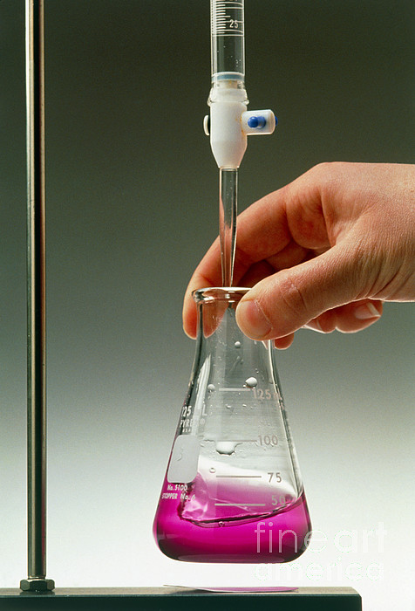
Double-replacement reactions (two types)
Two ionic compounds exchange ions to form new compounds
Examples: Precipitation (formation of solid) and Acid/Base

Slide 26
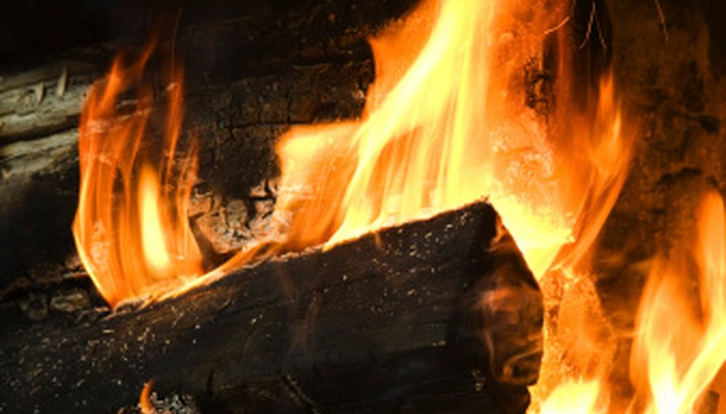
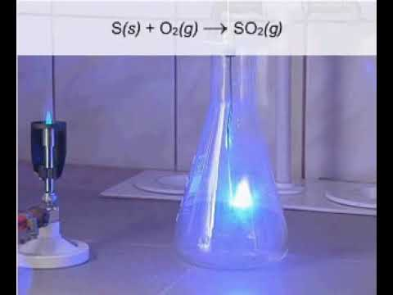
combustion
Burning of a substance in the presence of oxygen gas

Slide 27
Driving force of reactions in aqueous solutions
Generally: Reactions move forward to form lower energy substances
Double-replacement reactions form precipitates (solid); lower energy compound
Acid/base reaction driven by neutralization forming salt and water
Single-replacement, synthesis, and decomposition reactions involve transfer of electrons to form lower energy products (oxidation-reduction or redox)

Slide 28
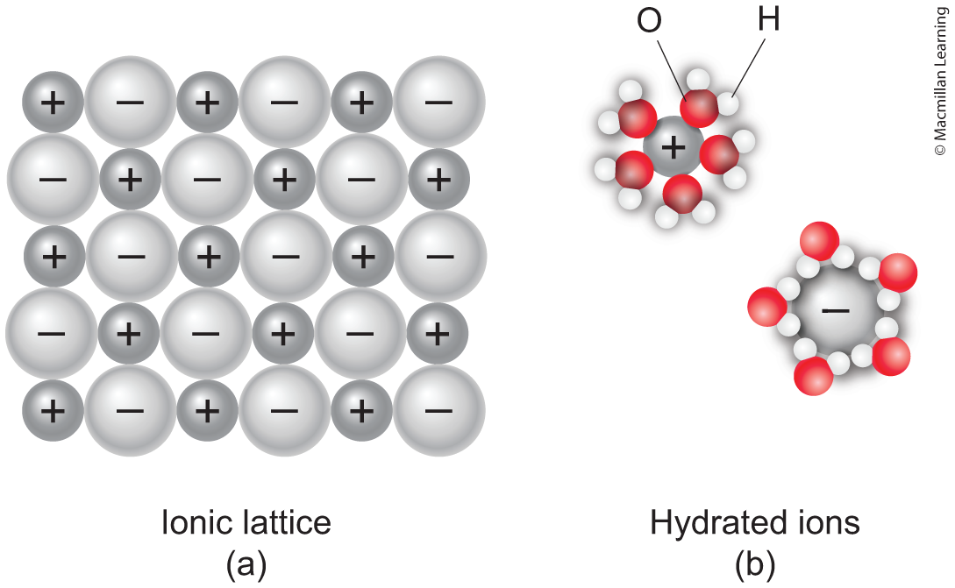
ionic compounds dissolved in water
Q: What does it mean when ionic compounds are dissolved in water?

Slide 29
Your turn: dissolving ionic compounds
Predict what and how much of each ion is formed from dissolving the following ionic compounds:
NaCl(aq)
KOH(aq)
CaCl₂(aq)
Pb(NO₃)₂(aq)
Na₃PO₄(aq)

Slide 30
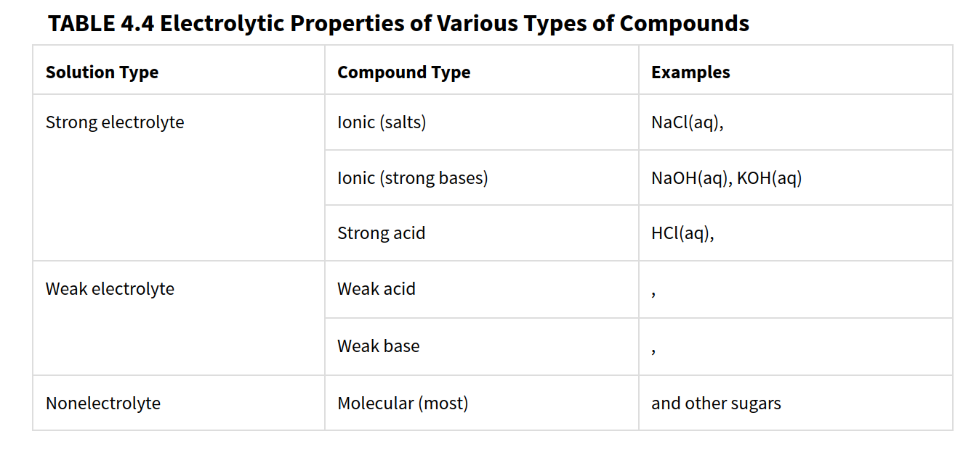
Strong, weak, and non-electrolytes

Slide 31
Precipitation reactions: solubility rules
Alkali earth metals and ammonium (NH₄⁺) are always soluble
Nitrates (NO₃⁻), chlorates (ClO₃⁻), perchlorates (ClO₄⁻), and acetates (C₂H₃O₂⁻) are always soluble
Chloride (Cl⁻), bromides (Br⁻), and iodides (I⁻) are soluble except with silver, lead, and mercury
Carbonates, sulfites, phosphates, and chromates are insoluble except with alkali earth metals and ammonium (NH₄⁺)
Barium, hydroxides (OH⁻) and sulfides (S²⁻) are insoluble
Silver (Ag⁺), mercury (Hg₂⁺), and lead (Pb²⁺) salts are insoluble
Sulfates are soluble except with calcium (Ca²⁺), strontium (Sr²⁺), and barium (Ba²⁺)

Slide 32
Examples: Predict the solubility
AgNO₃
PbSO₄
KOH
BaCl₂
MgCO₃
PbCl₂

